Slide 1
130 mm
60 mm
10 mm

Slide 2
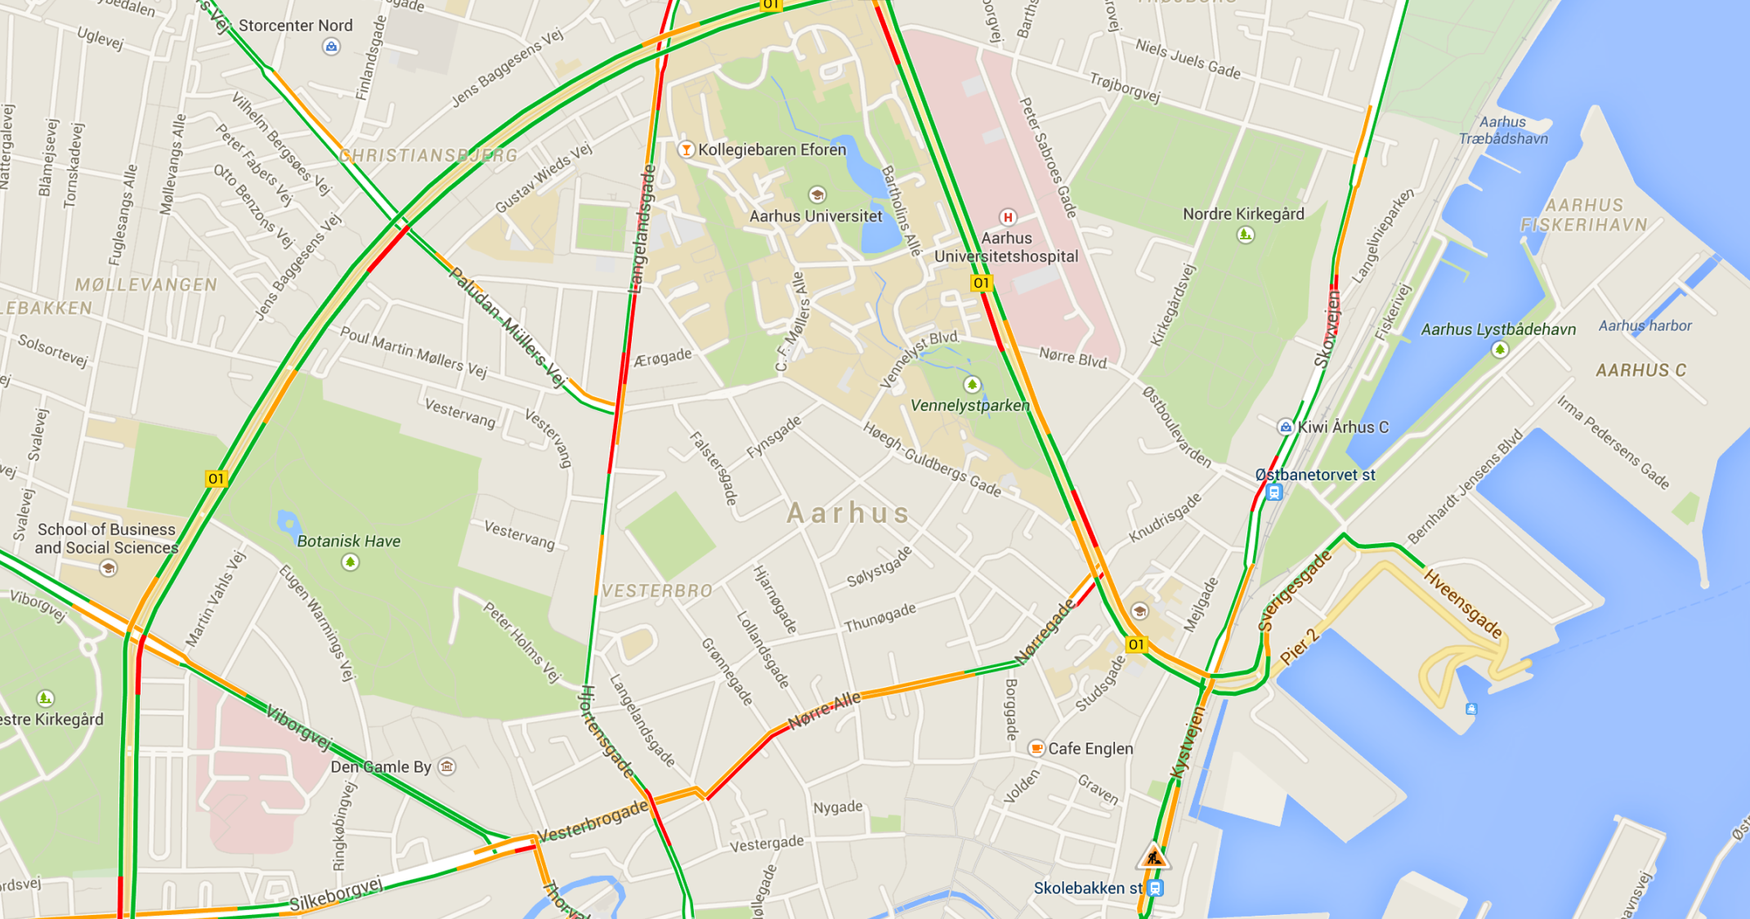
IIIIIIII
III

Slide 3
MAIN MENU
Dispatch order
View Log
IIIIIIII
Register event
Settings
III

Slide 4

MAPS
Road map (traffic)
IIIIIIII
Road map
Topographic
Population map
Infrastructure
III

Slide 5

IIIIIIII
Server is full!
Hvad er det I fylder jeres servere med?
III

Slide 6
MAIN MENU
MAPS
Dispatch order
Road map (traffic)
View Log
IIIIIIII
Road map
Register event
Topographic
Settings
Population map
Infrastructure
III

Slide 7

